Slide 1
8th grade
U.S. History
Mrs. Kristi M. Gomez
Hawks Team
Open House – August 27, 2015

Slide 2
Introduction
Graduated from University of North Florida with a Bachelor of Arts in Secondary Education - Social Studies
Currently pursuing my master’s degree in Educational Leadership from the University of West Florida
Eighth year teaching at LJHS
11th year teaching junior high students

Slide 3
What will my student study this year in this class?
United States History from the Age of Exploration to Reconstruction
U.S. History again in 11th grade with EOC

Slide 4
What kinds of activities will my student be doing in class?
Learning is more student centered than teacher centered
Historical document analysis
Photo analysis
Graphic organizers
Student stations
We read and write EVERY DAY

Slide 5
You will hear at home, “But it’s hard…”
Student centered learning is NOT easy.
They will be allowed to struggle through their thinking.
Difficult but do-able.

Slide 6
How will I know how my student is progressing in class?
FOCUS allows you access to your student’s grades in all six classes, track absences and tardies, and view any notes from the teacher. Available 24/7!

Slide 7
How do I sign up for FOCUS?
Complete a Release Student Information Form (I have some)
OR
Contact Donna Gysin, Records Secretary at 213-1813.
If you had a Focus account last year, there is no reason to sign up again.

Slide 8
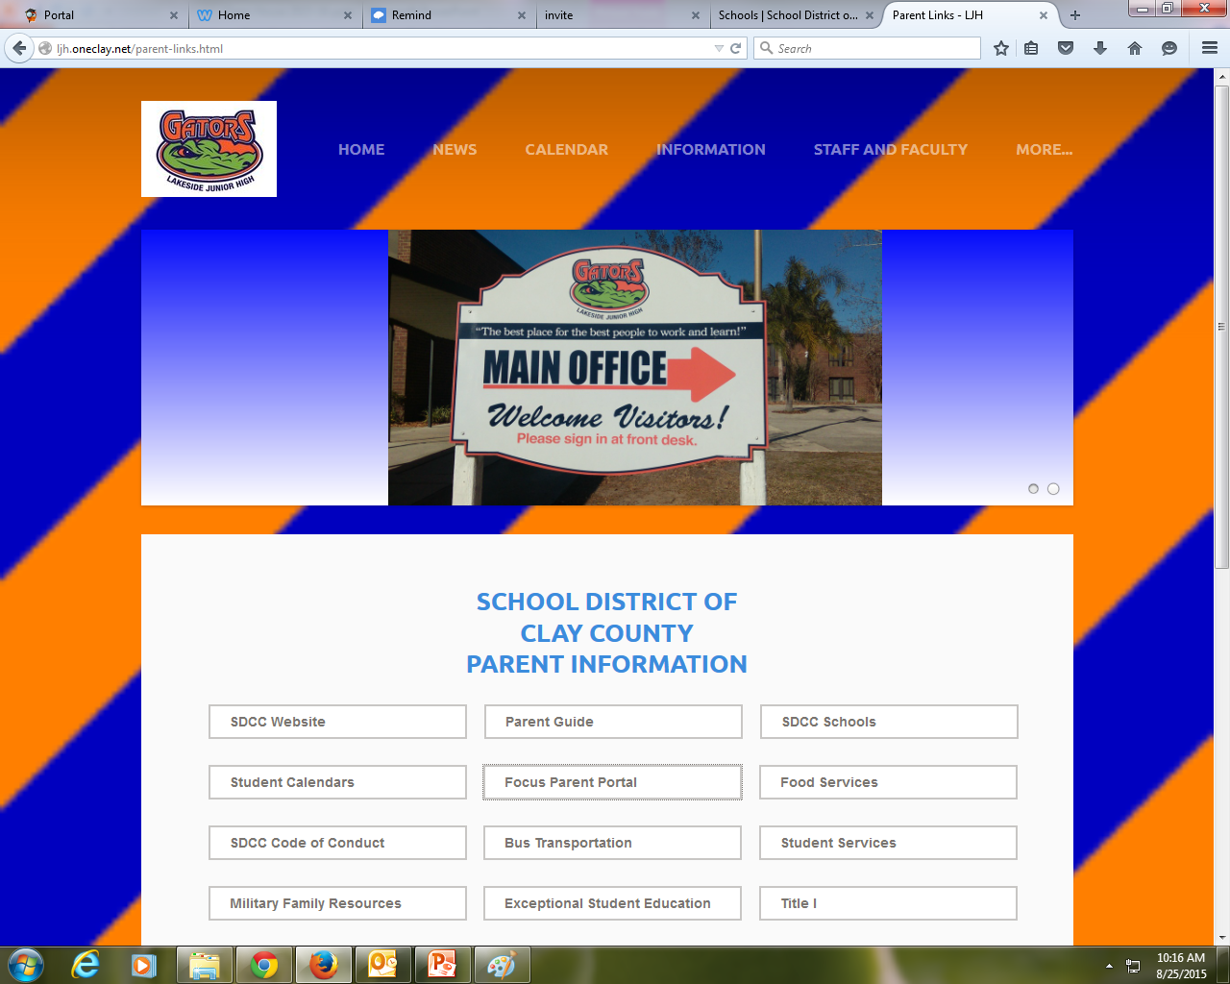

Slide 9
Reactive versus Proactive
As amazing as Focus is, it is a reactive tool, meaning that once you see the assignment in Focus, the due date has already passed and has been graded.
More helpful to you at home might be a more proactive tool such as Remind101 or the class website.

Slide 10
How will I know if my student has homework?
My very first daily expectation is for your student to write the homework in their student planner.
If there is no homework, your student should write “None”. There should never be a blank space.

Slide 11
How will I know if my student has homework?
Class website: http://kmgomezhistory.weebly.com/
**Updated daily or weekly**
Remind 101: Send a text message to 81010
In the message, put the following code:
  For 1st period: @gomezp1
  For 3rd period: @gomezp3
  For 4th period: @gomezp4
  For 5th period: @gomezp5
  For 6th period: @gomezp6

Slide 12
Late Work Policy
One extension pass per quarter (return syllabus signature sheet)
After using the extension pass, late work will be taken for partial credit only.
No late work will be accepted after five days.

Slide 13
Contact Information:
Email:
kmgomez@oneclay.net
School phone:
213-1800

Slide 14
Have a great year!
☺

